Slide 1
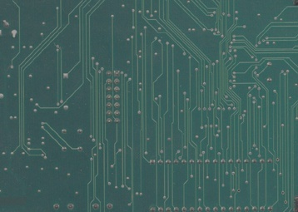
Operating Systems
Lecture#4
Scheduler and its types,
Scheduling Algorithms

Slide 2
Scheduling and Scheduler

Slide 3
Scheduling and Scheduler
Definition: When more than one process is runnable, the operating system must decide which one run first. The part of the operating system concerned with this decision is called the scheduler, and algorithm it uses is called the scheduling algorithm.

Slide 4
Types of Scheduler
Types of Scheduler
Primary Scheduler
Secondary Scheduler

Slide 5
Scheduling and Scheduler: Primary Scheduler
Primary Scheduler
Runs threads with the highest priority.
It then compares their priority and assigns resources to them, depending on their priority.
Threads with the highest priority will be executed for the current time slice.
With two or more threads with the same priority, they are put on a stack to allow each run on a given time slot.

Slide 6
Scheduling and Scheduler: Secondary Scheduler
Secondary Scheduler
It is responsible for increasing the priority of non-executing threads.
It is important that those low-priority threads are given a chance to run on the operating system and this is the function of this type of scheduler.

Slide 7
Scheduling and Scheduler
How scheduler knows the current status of each process?
We need to define states of processes so that scheduler can respond to each process

Slide 8
FOUR STATES OF PROCESS

Slide 9
FOUR STATES OF PROCESS
New
Ready
Running
Waiting
Terminated

Slide 10
FOUR STATES OF PROCESS
Ready: The process is in the main memory(RAM) and available for execution.
Blocked: The process is in the main memory and awaiting response.
Blocked/Suspend: The process is in secondary memory(hard disk) and awaiting response.
Ready/Suspend: The process is in the secondary memory(hard disk) but is available for execution as soon as it is loaded into the main memory.

Slide 11
FOUR STATES OF PROCESS
These four states helps the scheduler to respond to each process according to its current state so that process can be handled efficiently.

Slide 12
Scheduling Goals

Slide 13
Scheduling Goals
Fairness: Scheduler makes sure that each process gets its fair share of the CPU.
Efficiency: Scheduler must keeps the CPU busy 100 percent of the time.
Waiting time: Scheduler should minimize the waiting time for job.
Turnaround: Scheduler should minimize the time of how long processes must wait for output.
Throughput: Scheduler should maximize the number of jobs processed per hour.

Slide 14
Scheduling Algorithms

Slide 15
Preemptive and Non- Preemptive Scheduling Algorithms
Two types of scheduling algorithms:
Non-preemptive Scheduling
A scheduling is non-preemptive if, once a process has been given to the CPU, it cannot be taken away.
Preemptive Scheduling
A scheduling is preemptive if, once a process has been given to the CPU, it can be taken away.

Slide 16
Scheduling Algorithms
FCFS Scheduling
SJF Scheduling
SRTN Scheduling
Priority Scheduling
Round Robin (RR) Scheduling

Slide 17
FCFS(First Come First Serve) Scheduling algorithm

Slide 18
FCFS Scheduling algorithm
It is Non-preemptive Algorithm
Follows First-In-First-Out (FIFO) rule
Run-to-Completion
Run-Until-Finish

Slide 19
FCFS Scheduling algorithm
Runs the processes in the order they arrive.
Removes a process from the processor only if it is in block state or terminates.
Advantage: Good for long processes when they finally get on.
Disadvantage: Bad for short processes if they are behind a long process.

Slide 20
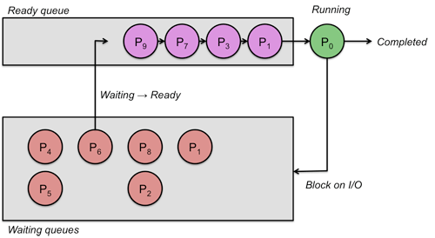
FCFS Scheduling algorithm

Slide 21
SJF(Shortest Job First) Scheduling algorithm

Slide 22
SJF Scheduling algorithm
Shortest-Job-First (SJF) is a non-preemptive scheduling algorithm.
In this algorithm the process which takes the shortest time to complete is run first.
It thus completes the processes that need a short time to be served and hence processes can be efficiently handled.

Slide 23

SJF Scheduling algorithm
P3 has shortest time unit of 2 and hence is scheduled first.
Process with same time units can be placed one after other.

Slide 24

SJF Scheduling algorithm

Slide 25
SRTN(Shortest Remaining Time Next) Scheduling algorithm

Slide 26
SRTN Scheduling algorithm
It is preemptive version of SJF.
Short job is given immediate preference to a running longer job.
The scheduler always chooses the process whose remaining run time is the shortest.
Must estimate expected remaining processing time
If the new job needs less time to finish than the current process, the current SJF process is suspended and the new job is finished by SRTN.

Slide 27

SRTN Scheduling algorithm

Slide 28
Priority Scheduling algorithm

Slide 29
Priority Scheduling algorithm
Each process is assigned a priority, and priority based process is allowed to run first.
Equal-Priority processes are scheduled in FCFS order.
The shortest-Job-First (SJF) algorithm is a special case of general priority scheduling algorithm.

Slide 30
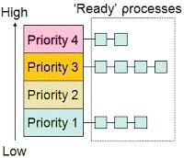
Priority Scheduling algorithm

Slide 31
Priority Scheduling algorithm
Examples of Internal priorities are
  Time limits.
  Memory requirements.
  File requirements,
  for example, number of open files.
  CPU Vs I/O requirements.

Slide 32
Priority Scheduling algorithm
Externally defined priorities are set by criteria that are external to operating system such as
  The importance of process.
  Type or amount of funds being paid for computer use.

Slide 33
Priority Scheduling algorithm
Priority scheduling can be either preemptive or non preemptive
  A preemptive priority algorithm will preempt the CPU if the priority of the newly arrival process is higher than the priority of the currently running process.
  A non-preemptive priority algorithm will simply put the new process at the head of the ready queue.

Slide 34
Priority Scheduling algorithm
A major problem with priority scheduling is indefinite blocking or starvation.
A solution to the problem of indefinite blockage of the low-priority process is aging.
Aging is a technique of gradually increasing the priority of processes that wait in the system for a long period of time.

Slide 35
Round Robin Scheduling algorithm

Slide 36
Round Robin Scheduling algorithm
Round-robin (RR) is one of the algorithms employed by process and network schedulers in computing.
In this algorithms time units or slices are allotted to process.
This time unit is also called quanta or quantum.
Equal time slices are allotted to each process in form of a queue.
Once the time or quantum has passed for a particular process, the process is sent to the end of the queue and next one is handled.

Slide 37
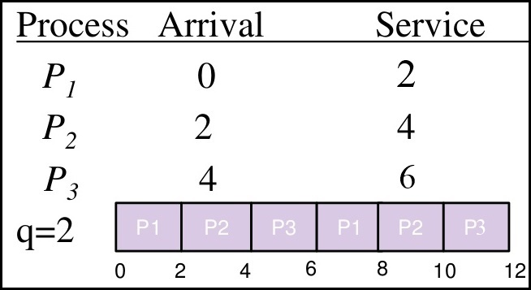
Round Robin Scheduling algorithm
Here q is quantum or time slice.

Slide 38
Round Robin Scheduling algorithm
Advantage of RR Algorithm: It is fair because each process gets equal share of CPU.
Disadvantage of RR Algorithm: If time slice is too short for any process, the CPU will get overloaded and it will also cause delay in process handling.

Slide 39
Application of RR Scheduling algorithm
In a computer for example, the user starts three applications, Email, a web browser, and a word processor.
These applications are loaded into system memory as processes and each is allowed to run without the user considering which applications are running in the background.

Slide 40
DEADLOCK

Slide 41
DEADLOCK
In this section we will now study some important concepts related to deadlocks.
This is also a major problem that an O.S has to solve.
Recall how a deadlock occurs.
A deadlock is a situation in which two computer programs sharing the same resource are preventing each other from accessing the resource, resulting in both programs ceasing to function.

Slide 42
RESOURCE

Slide 43
RESOURCE
A resource is anything that can be used by only a single process at any instant of time.
A resource can be the hardware device or a piece of information.
For example a printer is a hardware resource.

Slide 44
TYPES OF RESOURCE
Types of Resources
Preemptable Resource
Non-Preemptable Resource

Slide 45
RESOURCE
Preemptable Resource :
It is one that can be taken away from the process owing it.
Main memory(RAM) is an example of preemptable resource.
Non-Preemptable Resource:
It is one that cannot be taken away from the process owing it.
CD-ROM, Tape Drives, Printers etc are the examples of non-preemptable resources.

Slide 46


